Slide 2
System Block Diagram
VSS
VCC
VEE
RS
RW
E
D0
D1
D2
D3
D4
D5
D6
D7
LED+
LED-
16x2 LCD display
HD4478U
GPIO 60
GPIO 52
GPIO 57
GPIO 60
GPIO 89
GPIO 87
GPIO 58
LED
Pocket Beagle
SCL (I2C1)
SDA (I2C1)
SCL
SDA
Slide Switch
4mm SPDT 1P2T
GPIO 59
IMU
MPU-6050

Slide 3
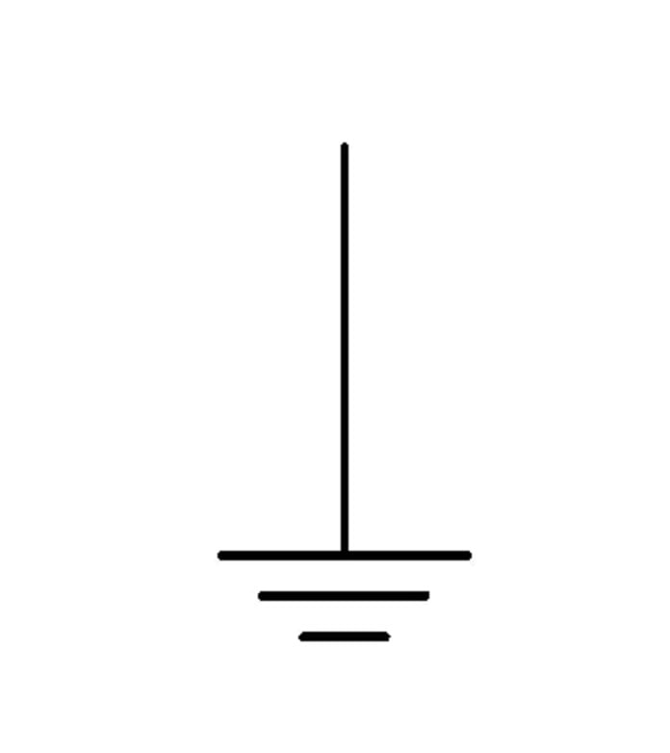
5V (~150mA)
3.3V
Power Block Diagram
VSS
VDD
V0
RS
RW
E
D0
D1
D2
D3
D4
D5
D6
D7
A
K
Variable resistor
LED
16x2 LCD display
HD4478U
SYS VOUT
Gnd
Pocket Beagle
GPIO 58
Slide Switch
SYS 3.3V
IMU
MPU-6050
SYS 3.3V
Gnd
VCC
GND
GPIO 59
1kΩ Resistor
3.3V
3.3V (500µA)

Slide 4
5V (~150mA)
Power Block Diagram
16x2 LCD display
HD4478U
SYS
VOUT
1x GPIO
LED
Pocket Beagle
SCL (I2C1)
SDA (I2C1)
Slide Switch
4mm SPDT 1P2T
IMU
MPU-6050
SYS 3.3V

